Slide 1
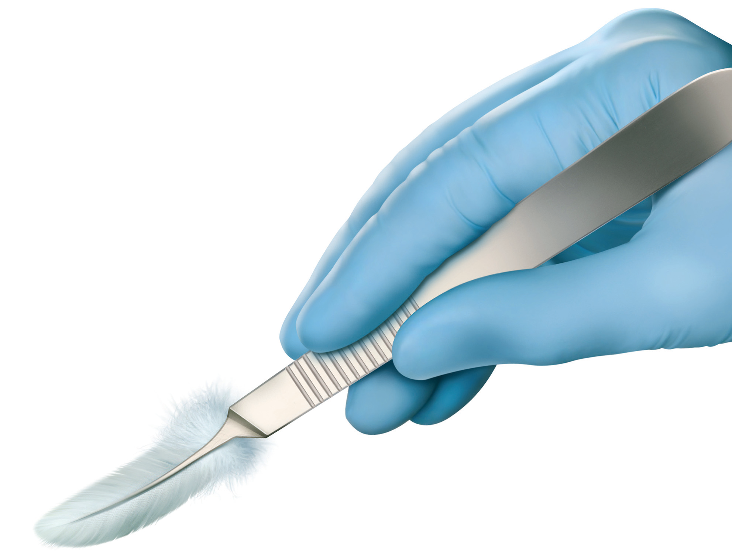
Fibroids
Melting away from the surgeons knife
Dr.RamyaJayaram
Consultant &MRgFUS Specialist
Notes:
DOC 1165181

Slide 2
Fibroids
25-40% of female population
Symptoms depend on location
Often associated with infertility
Reason for 1/3 of hysterectomies worldwide

Slide 3
Management modalities
Currently available strategies
Medical management
Surgical management
Myomectomy
Hysterectomy
Uterine artery embolisation

Slide 4
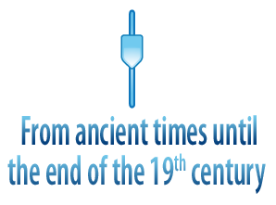
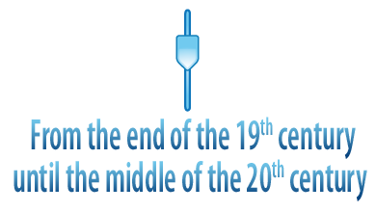
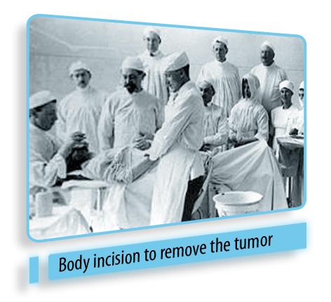
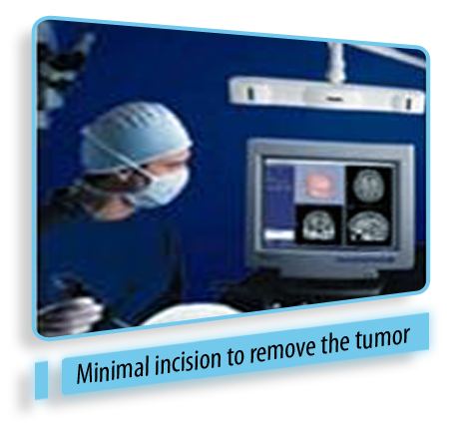
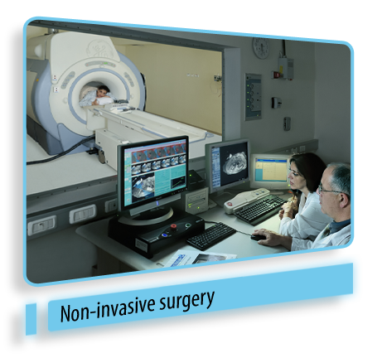
Evolution of Surgery
Notes:
DOC 1165181

Slide 5
The Future…..
MRI AS AN ALTERNATIVE TO SURGERY!!
The MRgFUS

Slide 6
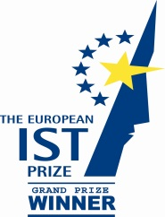
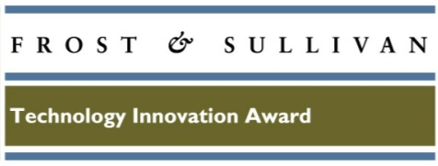
Pathbreaking technology!!!
one of 25 ideas for a changing world
“Technology Pioneers,” developing and applying “highly transformational and innovative technologies”
The Year’s 50 Best
Inventions
European Union IST grand prize for “innovative products and service to mankind”
Technical Innovation Award in field of non-invasive medical devices for outstanding industry achievement
Technology Innovation bronze medal
November 28, 2011
Notes:
DOC 1165181

Slide 7
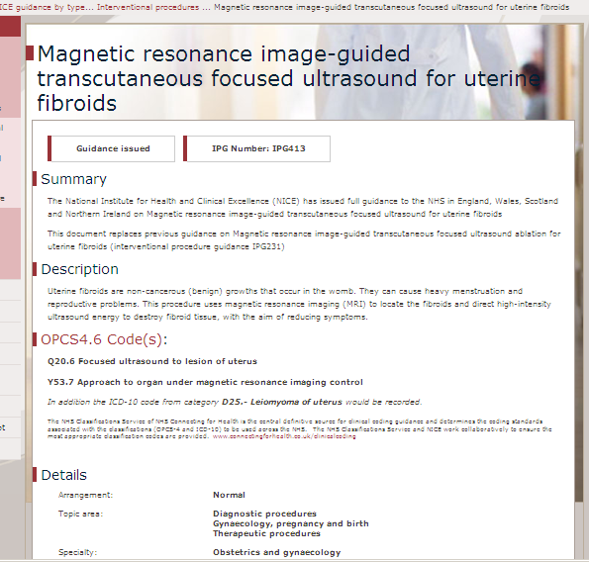
Updated NICE Guidelines - Nov. 2011
MRgFUS is safe and works well for use in the NHS
Current evidence on efficacy and safety of MRgFUSadequate to support the use of this procedure
Dozens of ExAblate peer reviewed papers reviewed (over 1000 patients).
NICE interventional procedures advise NHS when and how new procedures can be used in normal practice

Slide 8
What is MR guided Focused Ultrasound
(MRgFUS)?
Combination of two well known technologies
High intensity focused ultrasound to heat and destroy targeted tissue
Magnetic resonance imaging (MRI) for precise visualization, guidance and real time treatment control
&
Notes:
The concept of Focused ultrasound has been investigated for many years, but only with the advent of MRI has it been able to be brought into clinical use. MR is critical for treatment planning and for real time thermal mapping of the treatment area and surrounding healthy tissue. Real time monitoring allows the clinician to monitor treatment – ensuring ablation of the the targeted tissue and condition of surrounding tissue.
It has been labelled “star trek medicine” and has been awarded many awards for its potential to help mankind ( Wall St. Journal Technology award, European IST award, Economic Forum, etc. Business Week has called it “one of 25 ideas for a changing world.
The animation shows how focused ultrasound is used to treat fibroids. The fibroid is identified and treated spot by spot until the total planned region is treated
Focused ultrasound uses ultrasound energy,similar to that used in diagnostic imaging. When focused to deliver energy to a single point in the body, the intensity is higher and the temperature at the focal point rises to 60-80 degrees C, high enough to ablate the tissue. The focusing ensures that the energy density will be only at the focal point and low at other locations, and thus will not impact other tissues.
This animation shows the patient lying prone on the patient table entering the MR, with the transducer producing focused ultrasound beams, and its automated positioner correctly reaching each targeted spot.

Slide 9
Advantages of an MRI
Non invasive
No radioactive damage
Multiplanar imaging
transverse, sagittal, coronal, and non orthogonal views
Best modality for visualizing complex tissue

Slide 10
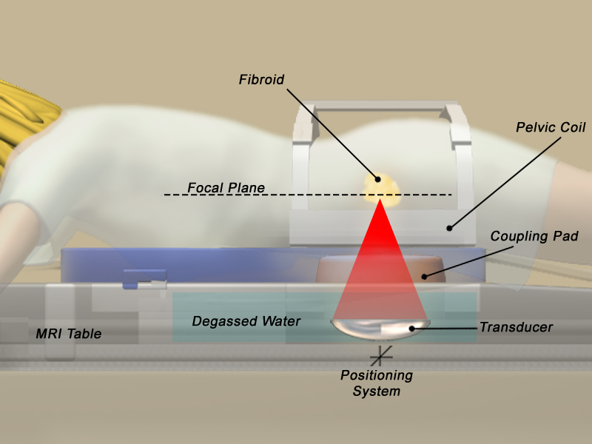
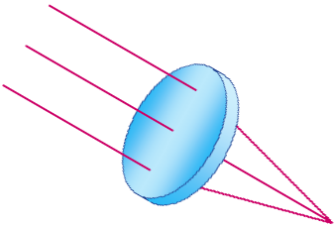
How Does Focused Ultrasound Work?
Focused ultrasound generates heat
Ablates tissue only at the focal point to 65-85ºC
Causes thermal coagulation and precipitation of intracellular proteins, resulting in cell death
Multiple sonications each lasting for 20-30 seconds
Notes:
10
The focused ultrasound beam is generated by a phased array transducer which is located in the patient table and passes through a water bath and gel pad which create acoustic coupling with the patient.
The effect of focusing ultrasound energy is similar to that of using a magnifying glass to focus the sun’s energy on a single point. However, unlike light, ultrasound energy can easily pass through the skin and propagate through tissue to converge to a focal point inside the body.
The focal point has the shape of a small bean. In few seconds, the tissue at the focus reaches a temperature level that causes cell destruction. The system then moves to another spot to ablate it,until all the planned spots are treated.
The size of the sonications can be varied, depending on the size and depth of the focal volume to be treated, ranging from 1x2mm to 10x30 mm.

Slide 11
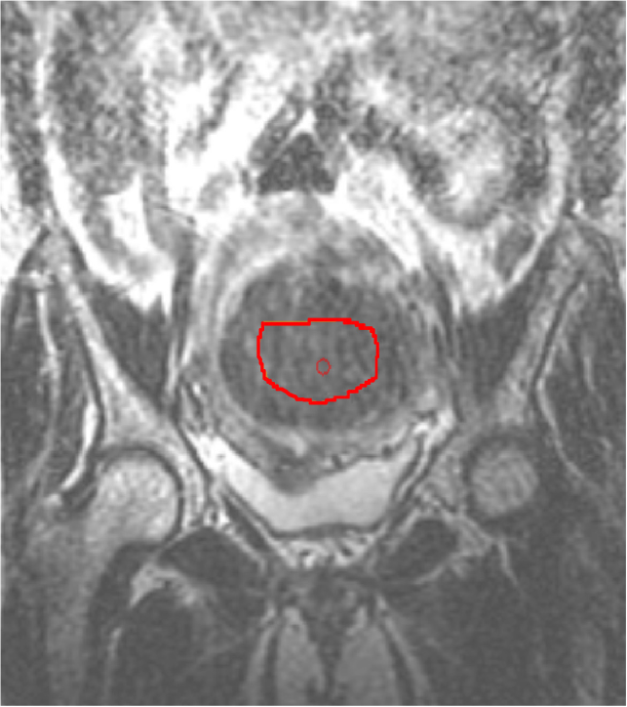
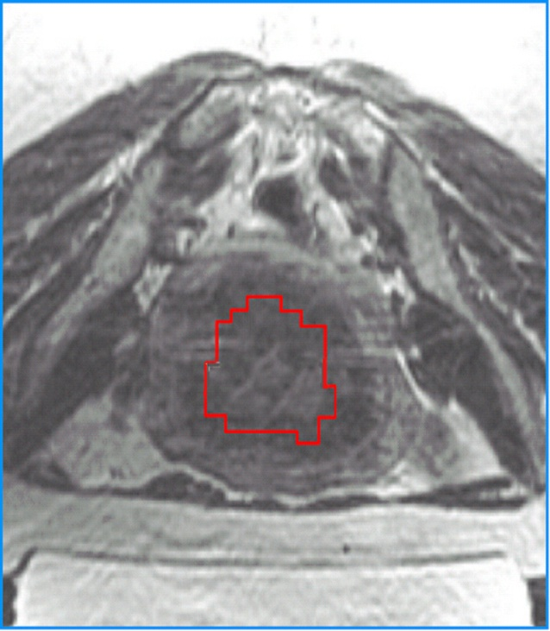
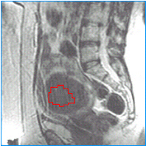
3D anatomic views for planning treatment region
Coronal
Axial
Sagittal

Slide 12
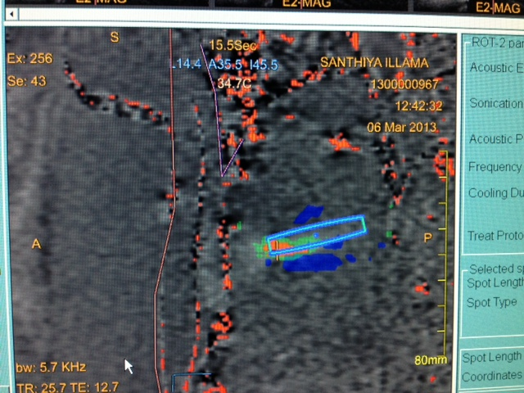
MR Thermometry
Post sonication
Temperatures achieved

Slide 13
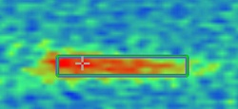
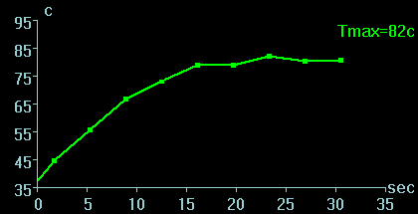
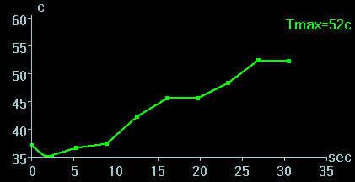
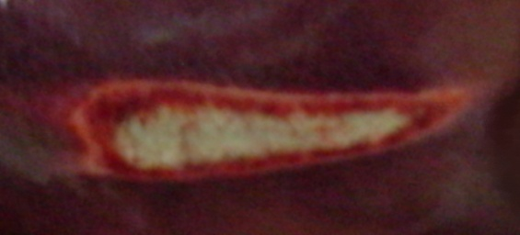
MR thermometry and tissue ablation
1
1
Temperature rise at center of sonication spot
3
2
Temperature map of a sonication
2
Temperature rise at margin
3
Temperature rise in untreated area, 7mm from center
1
3
2
Pathology of same sonication
Notes:
MR thermometry (temperature map and thermal dose) provides an accurate predictor of the amount of tissue ablation.
You can see here:
Real time thermometry along the beam path provides detailed thermal information about the heating at the focus and its surroundings
Calculated thermal dose of the same spot
Actual pathological results of this spot
Graph 1 shows the temperature rise during the sonication at the center of the spot (focus)
Graph 2 shows the temperature rise at the margin of the focus
Graph 3 shows the temperature rise 7 mm from the center, with almost no increase in temperature

Slide 14
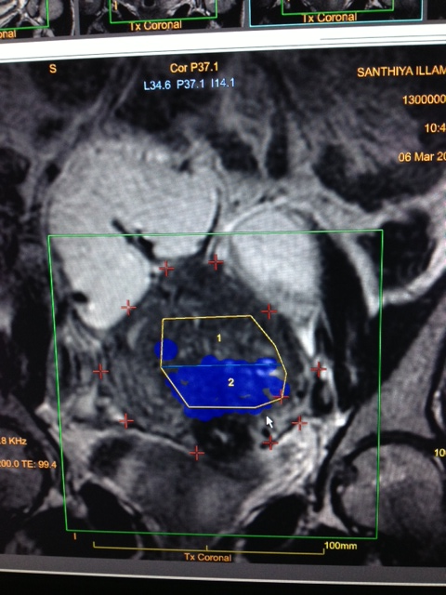
Region of treatment
Area left to sonicate
Area treated by previous sonication

Slide 15
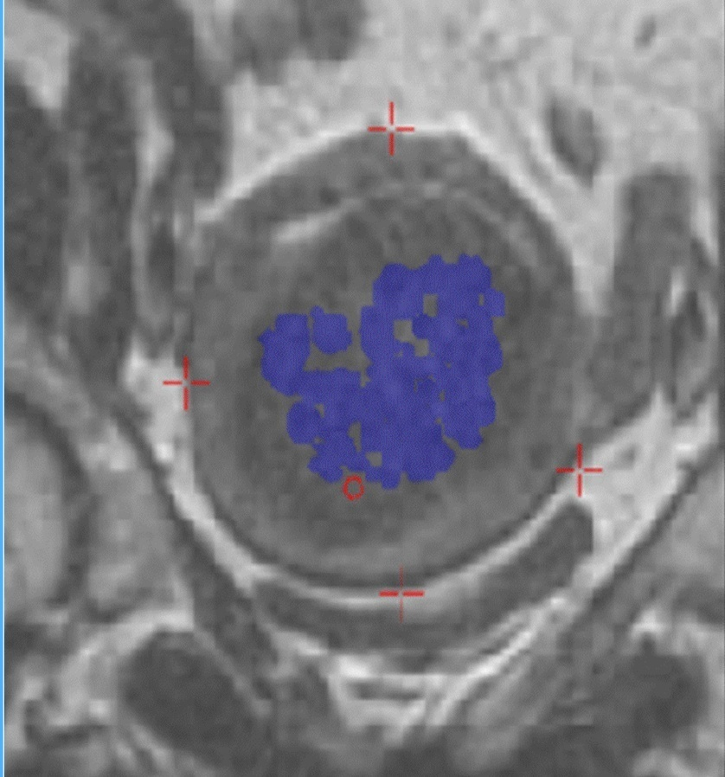
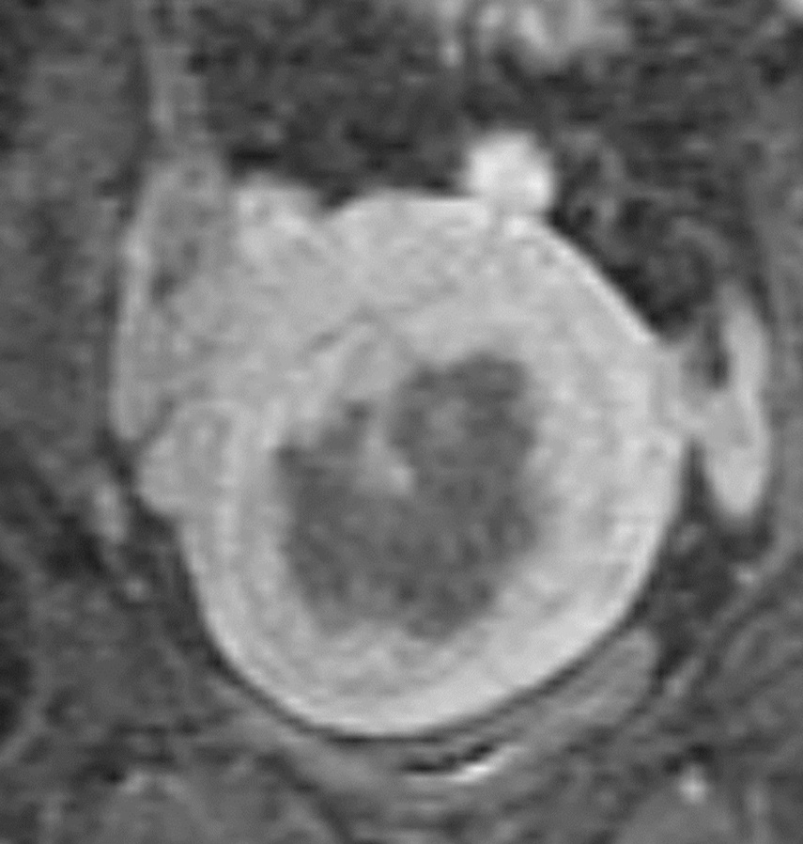
Outcome assessment
Immediate evaluation of thermal ablation effect
Treatment area
Post treatment image

Slide 16
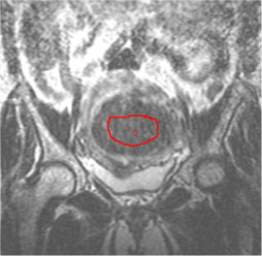
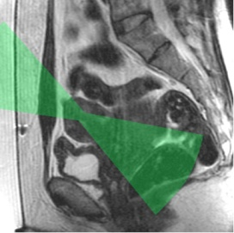
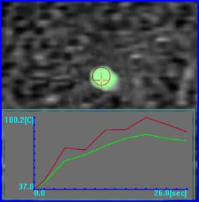
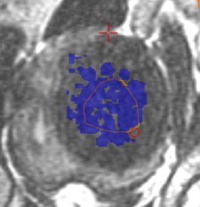
Safe and personalized treatment
3D anatomic information for exact tumor targeting
Beam path visualization & sculpturing for safe treatment
Real time MR thermometry to achieve planned outcome
Post treatment contrast imaging for evaluating treatment outcome
= Patient safety

Slide 17
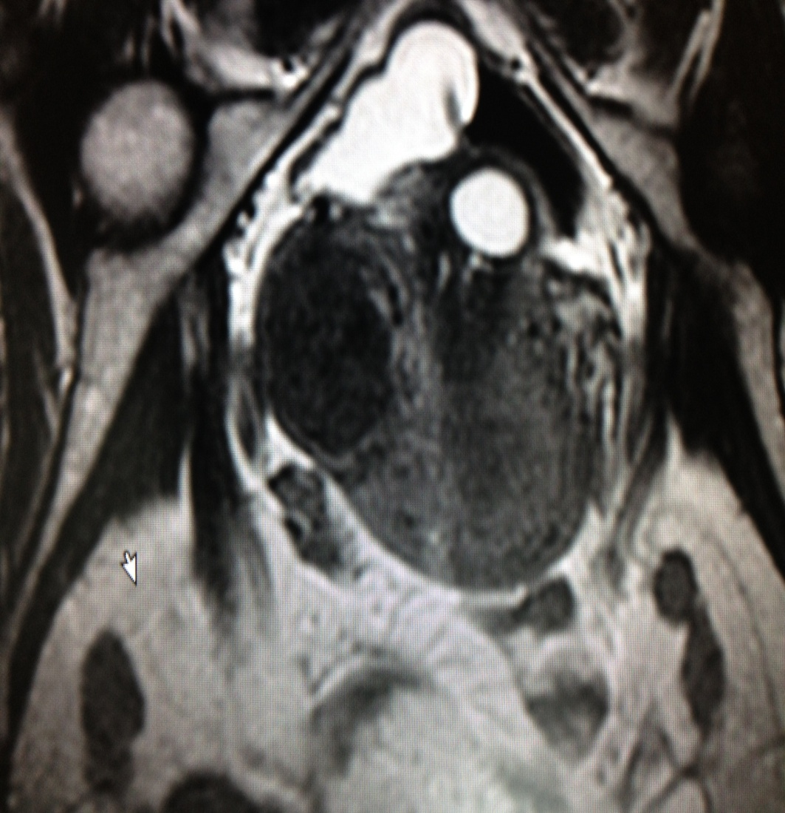
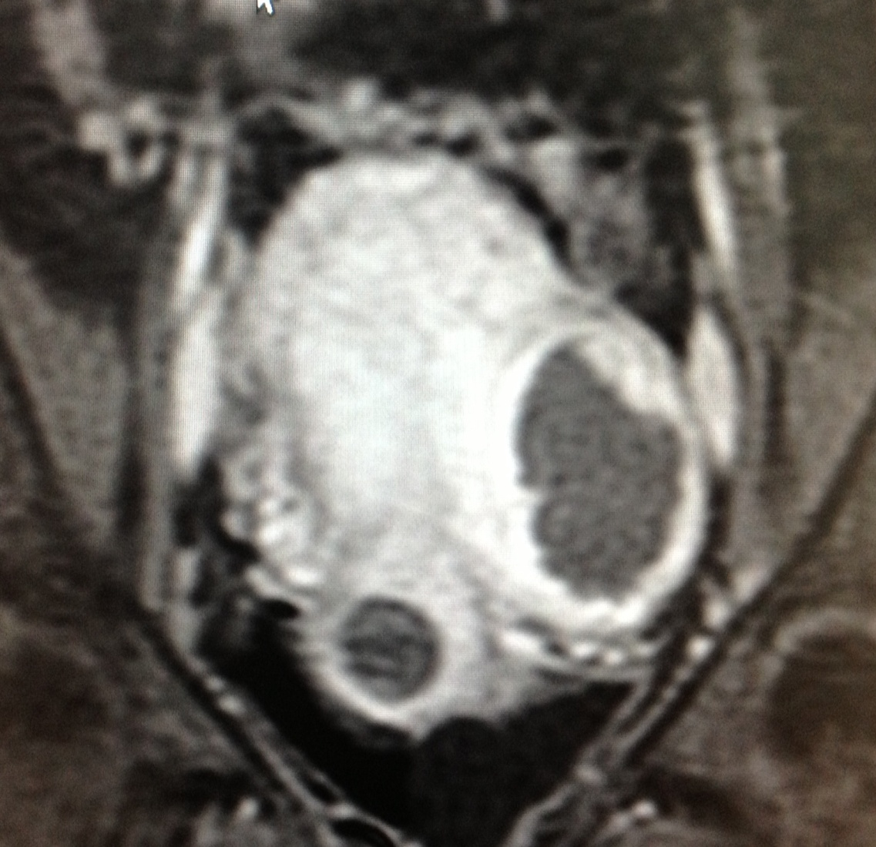
Treatments done at Womens Center
Before MRgFUS
Post MRgFUS
Mrs A, 30yrs.
H/O infertility for x 5 yrs. MRI imaging showed a large left lateral wall intra mural fibroid.
Post treatment NPV 85%

Slide 18
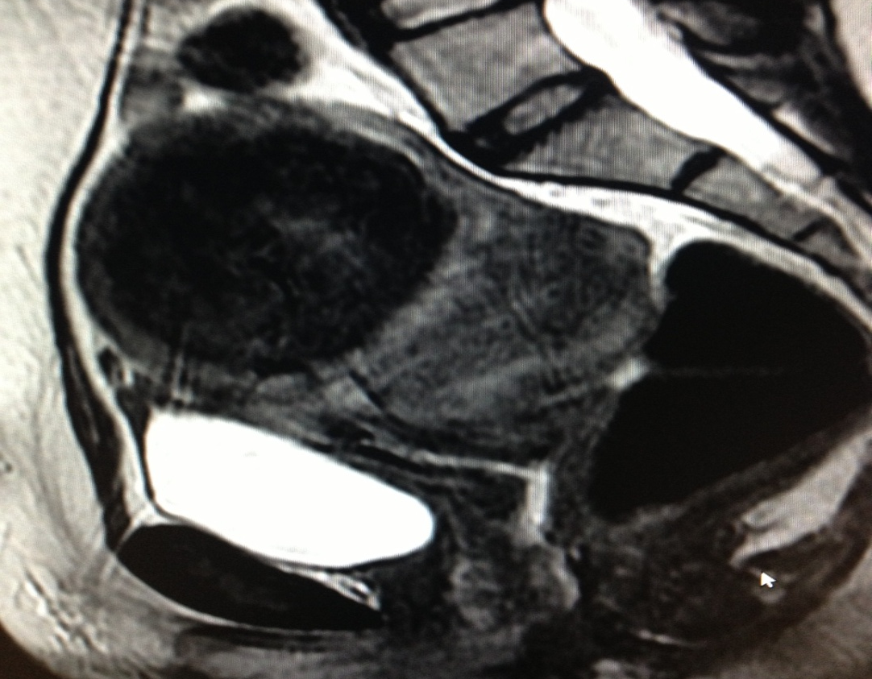
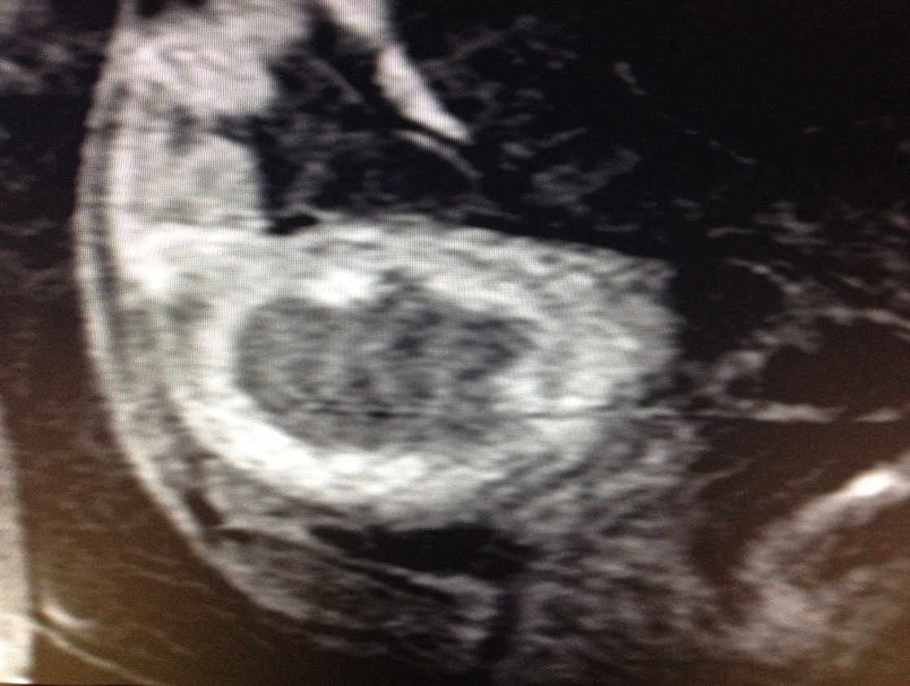
Treatments done at Womens Center
Before MRgFUS
Post MRgFUS
Mrs.M. 35yrs.
H/o heavy bleeding during cycle x 7 yrs. MRI showed a 8x 7.5 cm anterior wall intra mural fibroid
Post treatment NPV 80 %
Asymptomatic x4 months

Slide 19
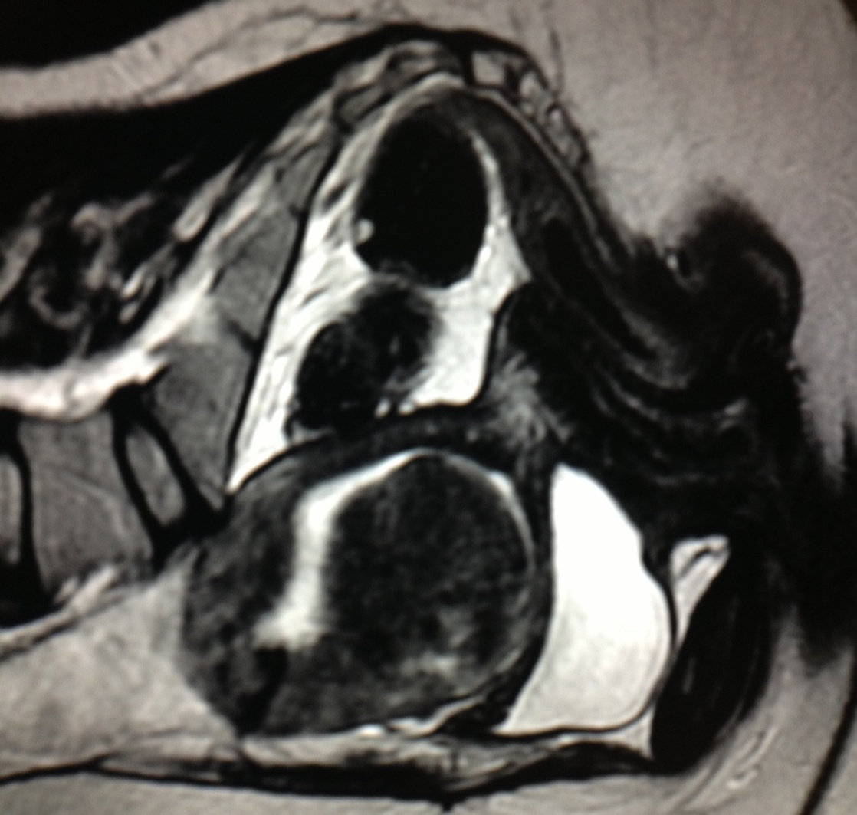
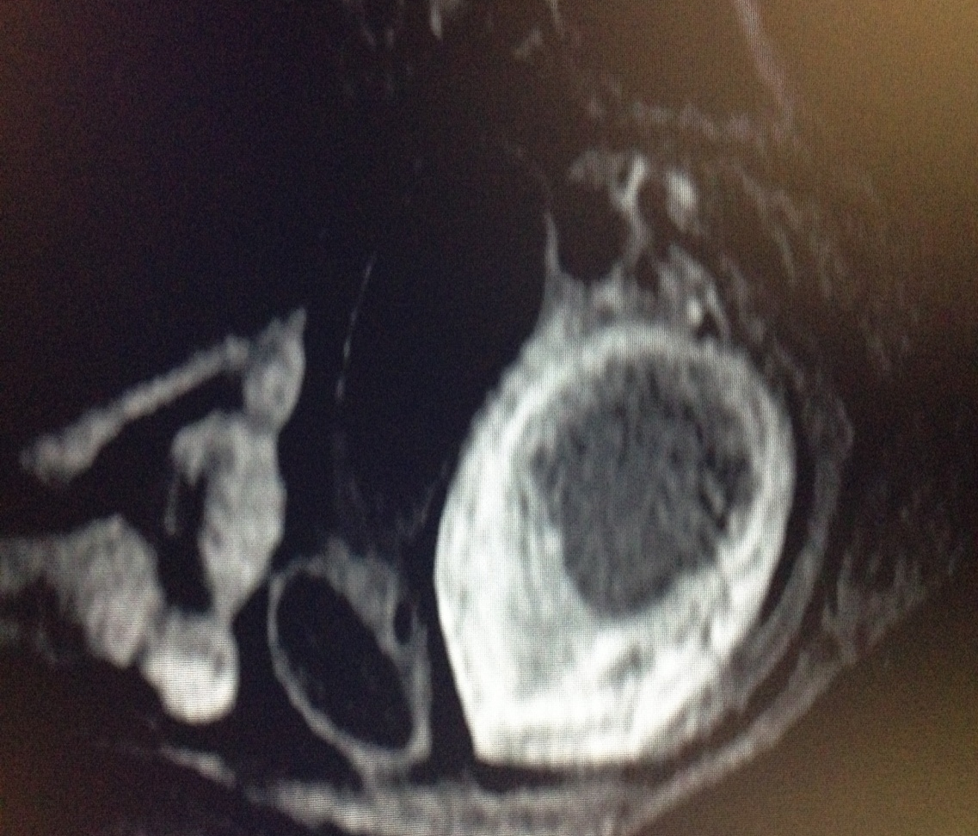
Treatments done at Womens Center
Before MRgFUS
After MRgFUS
Mrs . R, 38yrs.
H/o heavy bleeding during cycles x 3 yrs.
MRI showed a 7 x 6 cm intramural fibroid with > 70% intra cavitary component.
Post treatment NPV 88%. Asymptomatic x 2 months.

Slide 20
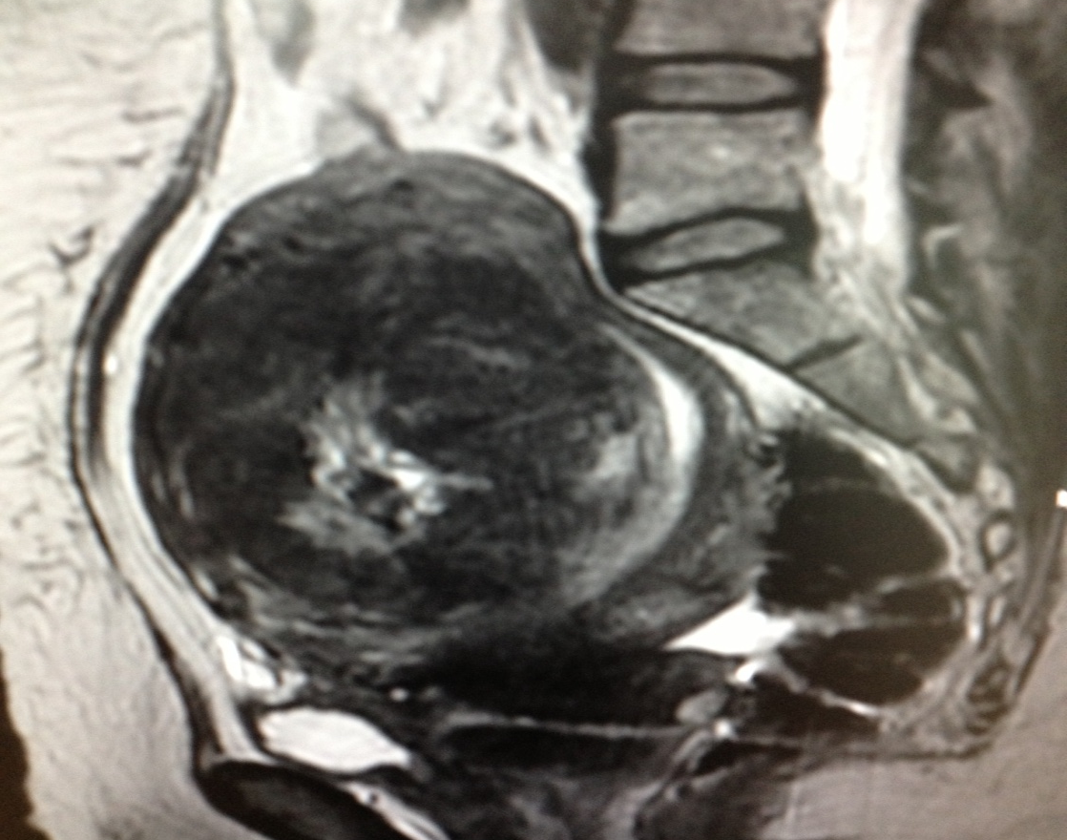
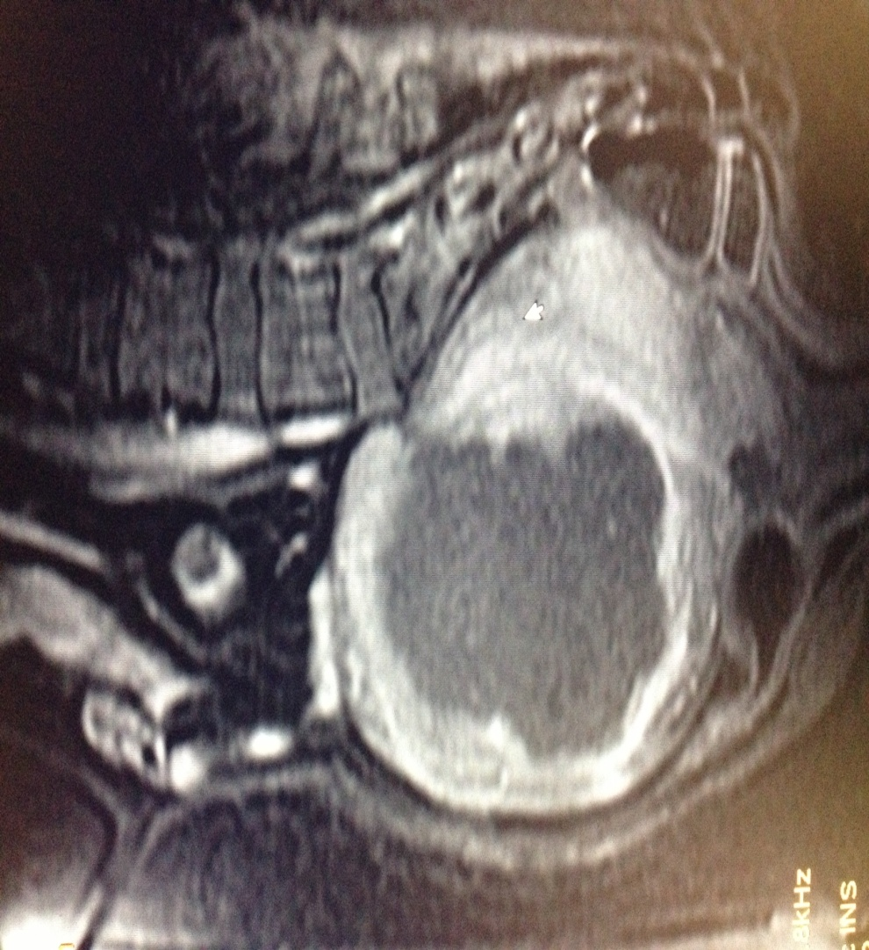
Treatments done at Womens Center
Before MRgFUS
Post MRgFUS
Mrs.SP, 48 yr with H/o irregular bleeding and heavy bleeding during cycles with bleeding lasting for 10 days
MRI showed a large 10 x 9 cm anterior wall intramural fibroid.
Post treatment NPV 85%
Asymptomatic x 4 months.

Slide 21
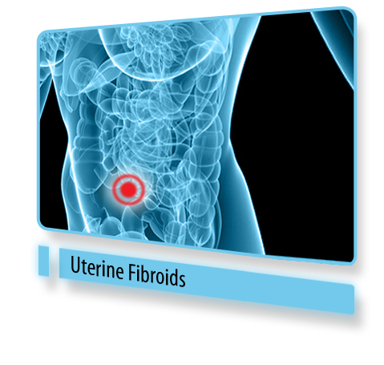
Advantage for patients
Non-invasive
Minimal discomfort and trauma
Return to normal activity in a day
Single session treatment
Drug sparing
No incisions, scars, post-operative complications or long-term sequlae
Preserving fertility, sexual function, continence
Notes:
21

Slide 22
Advantages for physicians
New therapeutic tool with potential
Solution for refractory / disease-recurring / Non-surgical candidates
Safe
High efficacy
No complications associated with surgery
Ability to re-treat and pre-plan stepwise therapy
Excellent choice for sub fertility associated with adenomyoma and fibroids.
Notes:
22

Slide 23
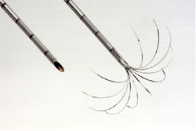
Advantages over Other Technologies
Precise Control of Treatment Zone
Leaves surrounding anatomy unaffected
Completely Non-Invasive (Incisionless)
Requires only mild conscious sedation
0.1mm Precision (5 Human Cells)
RF Ablation
Notes:
Multiple thermal therapies have been put into practice world wide , the advantage of MRfFUS OVER ATHER TECNOLOGIES

Slide 24
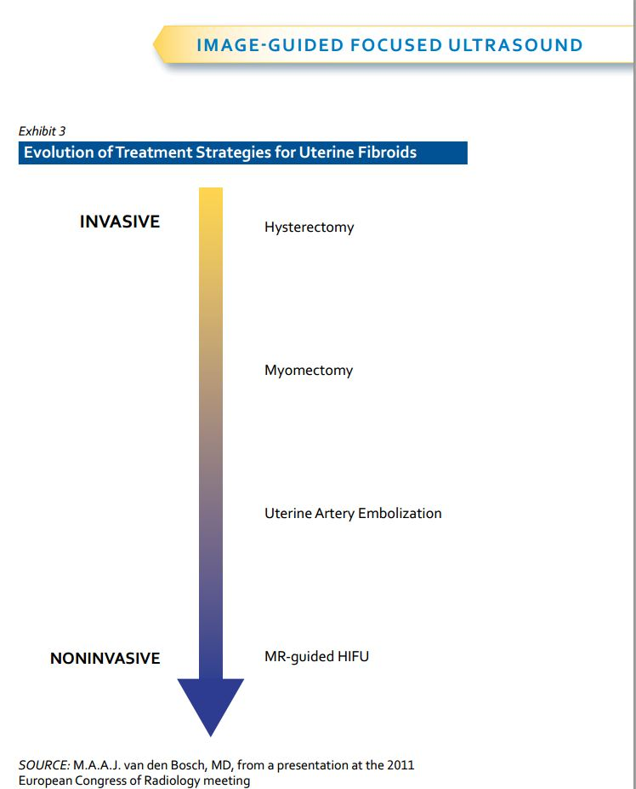
Comparison with other modalities
 | Hysterectomy | Myomectomy | Uterine Artery Embolization | MRgFUS
Return to Normal Activity | 28-56 Days | 44 Days | 10 Days | 1 Day
Hospital Days | 2-5 Days | 1-3 Days | 1 Day | 0
Procedure Time | 1.5-3.0 Hours | 1-3Hours | 0.75-2 Hours | 3 Hours
Notes:
DOC 1165181

Slide 25
Requirement of further treatment
Need for Alternative Treatment | @ 12 mo | @ 24 mo | References
Myomectomy | 10.6% | 13% - 16.5% | 1,2,3,4
UAE (Uterine Artery Embolization) | 7% - 10% | 12.7% - 23.7% | 5,6,7
ExAblate using MRgFUS NPV >60% | 6% (NPV=60%) Using former version | 13% (NPV=60%) Using former version | 8
References
Subramanian S, Clark MA, Isaacson K. Outcome and resource use associated with myomectomy. Obs& Gyn.2001; 98: 583-587
Nezhat FR, Roemisch M, et al. Recurrence rate after laparoscopic myomectomy. Am Assoc GynecolLaparosc. 1998;5: 237-240
Rossseti et al. Long term results of laparoscopic myomectomy: recurrence rate in comparison with abdominal myomectomy. Hum Reprod. 2001:16:770-774
Doridot et al. Recurrence of leiomyomata after laparoscopic myomectomy. J Am Assoc GynecolLaparosc. 2001;8: 495-500
Spies JB, Bruno J, et al. Long-term outcome of uterine artery embolization of leiomyomata. Obstet Gynecol. 2005; 106: 933-939
Goodwin SC, Spies JB, et al. Uterine artery embolization for treatment of leiomyomata: long-term outcomes from FIBROID registry. Obstet& Gynecol. 2008; 111: 22-32
Sharp HT. Assessment of new technology in the treatment of idiopathic menorrhagia and uterine leiomyomata. Obstet Gynecol. 2006;108: 990–1003
Stewart EA, Gostout B, Rabinovici J, et at. Sustained relief of leiomyoma symptoms by using focused ultrasound surgery. Obstet& Gynecol. 2007;110: 279-287
Morita Y, Ito N, Hikida H, Takeuchi S, Nakamura K, Ohashi H. Non-Invasive Magnetic Resonance Imaging Guided Focused Ultrasound Treatment for Uterine Fibroids – Early Experience, Eur J ObstetGynecolReprod. Biol., 2008, 139(2):199-203
Notes:
25

Slide 26
Patient Selection
Exclude patients that:
Weigh more than 115 Kg (250 lb)
Have contradictions to MRI
Uterine size more than 900 cc or 24 weeks size.
Have massive abdominal scarring
Have symptomatic pedunculated fibroids
Notes:
26

Slide 27
Selection criteria for fibroids
Fibroid(s) should be device accessible
Fibroid(s) should enhance on MR contrast imaging
Fibroid(s) envelope should not be significantly calcified

Slide 28
Predictive factors
Most important predicting factor for treatment durability is immediate post-treatment non-perfused volume (NPV) and symptom severity scoring (SSS)
Enhanced T1w
NPV
Notes:
28

Slide 29
Case studies
Uterine Leiomyomas: Review of a 12-month Outcome of 130 Clinical Patients
150 patients treated
130 completed 12 month follow-up
Mean tumor load 350 cm3 ( range 18-1845 cm3)
Symptom relief: 85.7%, 92.9%, 87.6% at 3, 6, and 12 months
Gorny KR‚ Woodrum DA‚ Brown DL‚ Henrichsen TL‚ Weaver AL‚ Amrami KK‚ Hangiandreou NJ‚ Edmonson HA‚ Bouwsma EV‚ Stewart EA‚ Gostout BS‚ Ehman DA‚ Hesley GK.
May 2011, J VascIntervRadiol.

Slide 30
Long-term Outcomes
Treatment for Symptomatic Uterine Leiomyomata
Fifty-one leiomyomata in 40 patients were treated
The mean baseline volume of treated leiomyomata was 336.9 cm³
The mean improvement scores for transformed SSS was 47.8 (P< .001) at 3 years
There were no long-term complications
Conclusions
Long-term follow-up data from MRgFUS treatments show sustained symptomatic relief among enrolled patients
Hyun S. Kim MDª, Jun-Hyun BaikMDª, Luu D. Pham MA^{c}, Michael A. Jacobs

Slide 31
MRgFUS and Infertility
Successful in vitro fertilization pregnancy following magnetic resonance-guided focused ultrasound surgery for uterine fibroids
A 45-year-old para 0 + 1, with four previous failed IVF treatments
Underwent MRgFUS for a single anterior wall fibroid causing intra-cavitary distortion.
Conceived after the first IVF cycle 10 months following the procedure.
Zaher S‚ Lyons D‚ Regan L. St Mary’ s hospital London
J ObstetGynaecol Res. 2011 Apr;37(4):370-3.
Notes:
We describe an in vitro fertilization (IVF) pregnancy and delivery after magnetic resonance-guided focused ultrasound (MRgFUS) for a symptomatic uterine fibroid.

Slide 32
Studies: Post-MRgFUS Pregnancies
Rabinovici J, Inbar Y, Eylon-Cohen S, Schiff E, Hananel A, Freundlich D; Pregnancy and live Birth after Focused Ultrasound Surgery for Symptomatic Focal Adenomyosis: A Case Report, Human Reproduction, 2006, pp. 1-5
Miriam M. F. Hanstede, M.D., Clare M. C. Tempany, M.D., and Elizabeth A. Stewart, M.D. Focused ultrasound surgery of intramural leiomyomas may facilitate fertility: A case report; Article in press
LP Gavrilova-Jordan, CH Rose, KD Traynor, BC Brost and BS GostoutSuccessful term pregnancy following MR-guided focused ultrasound treatment of uterine leiomyoma; Journal of Perinatology (2007) 27, 59–61
Y. Morita, N. Ito, H. Ohashi;Pregnancy and birth after MR guided focused ultrasound surgery for an a-symptomatic uterine fibroid; Accepted to: International Journal of Gynecology & Obstetrics
Notes:
Since we were limited in the pivotal trial to women who were family complete, we decided to investigate whether or not women treated with MRgFUS could get pregnant and carry a baby to term without undo difficulty.
As we do not cause any damage to the uterus ( no adhesions, etc) there should be no reason to prevent this. The initial results support this view.
Two patients suffered adverse effects – one had severe bleeding following additional myomectomy procedure and the second non-complete placenta removal. Both are considered unrelated to the MRgFUS treatment.

Slide 33
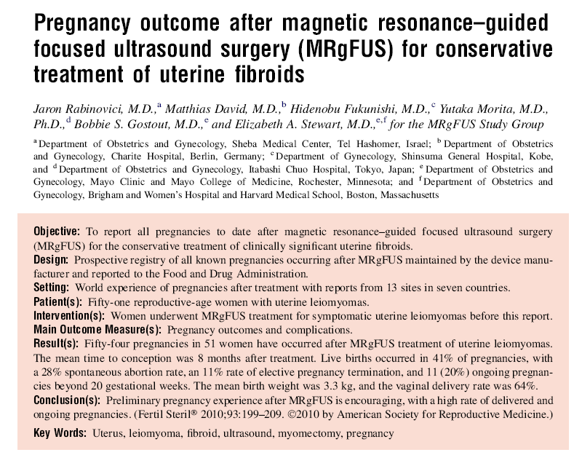
Fertility and sterility Vol.93 , No 1 ,January 2010

Slide 34
Comparison of Deliveries after MRgFUS
The following risks were NOT seen in any of the cases:
Uterine rupture,
Preterm labor,
Placental abruption,
Abnormal placentation leading to fetal growth restriction
Compared to other uterine sparing techniques MRgFUS results in:
Vaginal delivery rates more similar to general population
Preterm delivery rates similar to of general population
References: Cardozo E, Segars J et al. Estimated annual cost of uterine leiomyomata in US. AJOG, March 2012. published online Dec 2011. J. Goldberg and Leonardo Pereira. Pregnancy outcomes following treatment for fibroids: UAE versus laparoscopic myomectomy, Obstetrics and Gynecology 2006, 18:402–4 H. Homer, E. Saridogan, UAE for fibroids is associated with an increased risk of miscarriage, Fertility and Sterility 2009 J. Rabinovici et al. Pregnancy outcomes after magnetic resonance–guided focused ultrasound surgery (MRgFUS) for conservative treatment of uterine fibroids, Fertility and Sterility 2008.Miller CE. Unmet Therapeutic Needs for Uterine Myomas. J Minimally Invasive Gynecol. 2009;16: 11-21.
Notes:
34

Slide 35
MRgFUSfor the Treatment of Adenomyosis

Slide 36
Incidence
Adenomyosis found in
54% of young women with infertility, dysmenorrhoea and/or menorrhagia.
27%-50% of women with endometriosis
Kunz et al. (2005), Bazot et al( 2004)

Slide 37
Incidence
Difficult to evaluate even in the general population
Evidence from imaging, shows that it is not confined to older women
Detected in young symptomatic and also in young asymptomatic patients
Available data only for hysterectomy done for most severe forms.

Slide 38
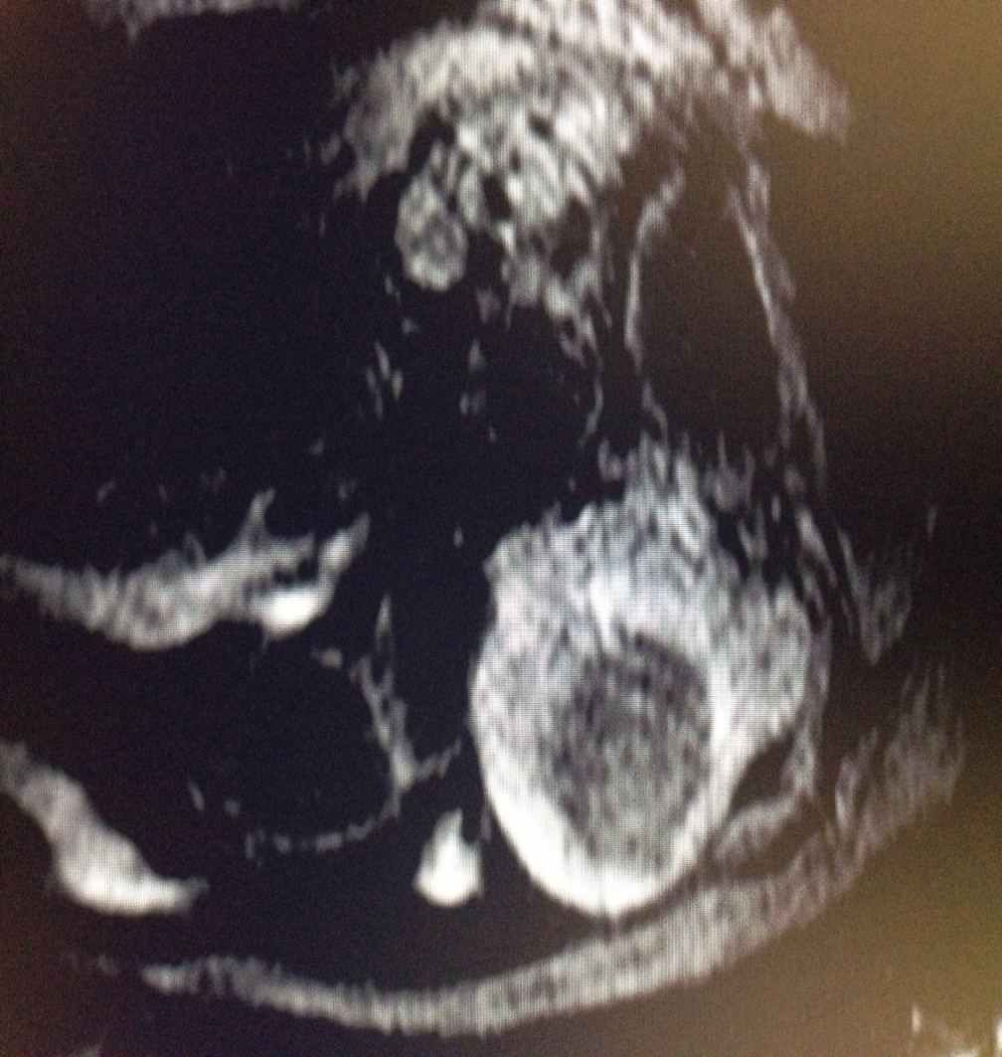
Treatment of Adenomyosis at Womens Center
Before MRgFUS
Post MRgFUS
Mrs.BS,34 yrs .
H/o infertility x 4 yrs with c/o sever lower abdomen pain and heavy bleeding during cycles
MRI showed diffuse adenomyosis involving anterior and posterior walls
Post treatment she is asymptomatic x 3 month.

Slide 39
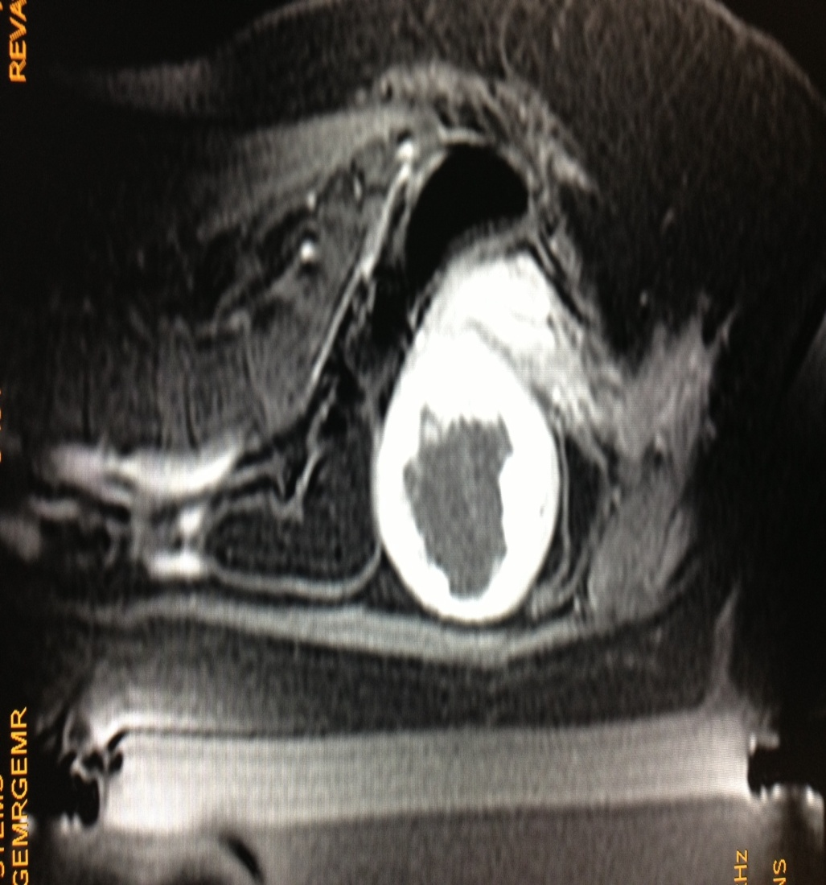
Treatment of Adenomyosis at Womens Center
Before treatment
After treatment
Miss P, 25yrs
H/O heavy bleeding during cycles x 6 yrs
MRI showed posterior wall and fundaladenomyosis
Post treatment asymptomatic x 2 months

Slide 40
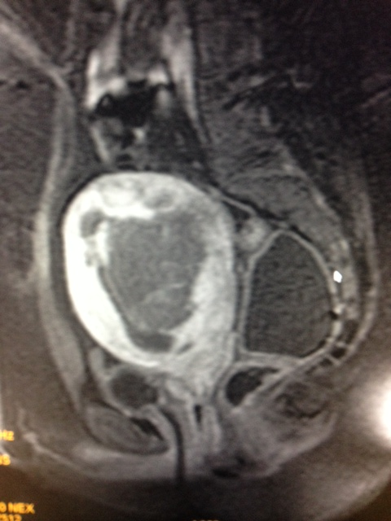
Treatment of Adenomyosis at Womens Center
Before MRgFUS
Post MRgFUS
Mrs.B, 34yrs.
H/O infertility for x 2 yrs with heavy bleeding and lower abdomen pain during cycles with cycles lasting for 10-15 days.
MRI showedposterior wall adenomyosis
Post treatment – Asymptomatic x 3 months

Slide 41
MRgFUSfor Adenomyosis
Fukunishi H, Funaki K, Sawada K et al. “Early results of magnetic resonance-guided focused ultrasound surgery of adenomyosis: analysis of 20 cases”. J. Min. Inv. Gynecol. (2008); 15:571–579.
Ken T, Kaori T, Tsuyoshi I, Nobuko M, Toshitaka F, Takashi K. “MR Imaging Findings of Adenomyosis: Correlation with Histopathologic Features and Diagnostic Pitfalls”. RadioGraphics (2005); 25:21–40.
Azziz R. Adenomyosis: current perspectives. ObstetGynecolClin North Am 1989; 16:221–235.

Slide 42
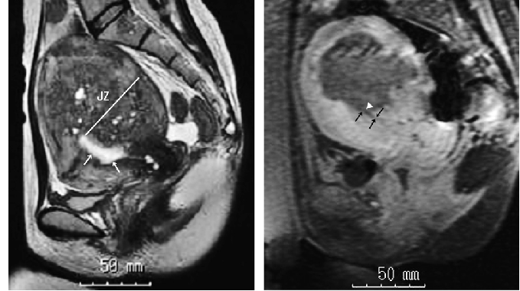
Clinical case:Adenomyosis
40 patients reached 12 months follow up with significant symptoms improvement which is consistent after the treatment and during the follow up (P<0.01).
High safety profile, and no serious adverse events.
Before MRgFUS
Immediately after MRgFUS
T1-w MR image , showing the adenomyosis tissue is non enhancing post treatment
Graph shows Symptom Severity Score data of 40 treated patients at 12 months follow-up
Published paper:Fukunishi H, Funaki K, Sawada K, Yamaguchi K, Maeda T, Kaji Y. Early Results of Magnetic Resonance Imaging-guided Focused Ultrasound Surgery of Adenomyosis : Analysis of 20 Cases, JMIG, 2008.

Slide 43
Device related adverse events
Non-Significant
Pain in the area of treatment
Swelling or firmness in treated area
Minor (1º or 2º) skin burns less than 2 cm in diameter
Significant
None
No patient deaths
No urgent unintended procedures
No hospitalizations for pain control
No post-embolization syndrome
Notes:
We were required to list all adverse events, whether related to treatment or not, but had very low rate in general. Regarding the significant, based on what we learned have changed the protocol and pre-treatment( i.e. carefully shaving patients pelvic area) so that we minimize the risks of these, and have seen very few significant adverse events since.
Following treatment patient do not suffer pain usually (as is common in UAE).
Compared to surgery this complications are really negligible.
These results are from a Post Marketing Surveillance FDA study of 160 patients in the US.

Slide 44
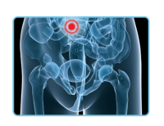
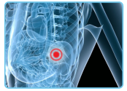
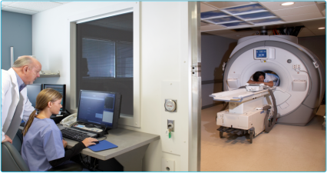
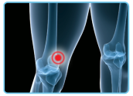
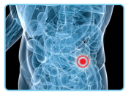
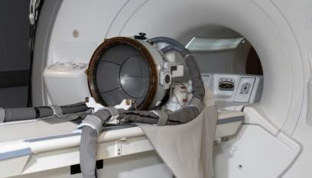
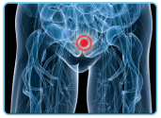
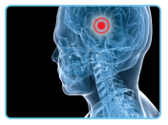
MRgFUS Indications
Next Generation Operating Room
Uterine benign tumors
Breast cancer *
Phase 2
Bone metastasis *
CE, FDA phase 3 study
Liver cancer *
Phase 1 outside US
Prostate cancer *
Phase 1 outside of US
Brain treatments *
Phase 1
44
Notes:
44

Slide 45
Take home message
MRgFUS solution:
1-time outpatient procedure (3-4 hours), replacing surgery
Significantly improved safety vs. surgery – eliminates excessive bleeding, infection, bloating, incontinence
Return to regular routine within a day
Approx. 11,000 women treated worldwide
Notes:
DOC 1165181

Slide 46
With sound waves taking the place of stitches,
it is a sound life for women out there.
Thank you.
Notes:
DOC 1165181

